Slide 1

MINI-PROJECT FINAL PHASE
Virtual mouse control using hand gesture
Presented By:
Anitha P 1DS19IS017
Avani K S 1DS19IS025
Gowthami Holla 1DS19IS042
Kruthi R Aithal 1DS19IS052
Under The Guidance Of
Mr. Suresh Kumar M
Asst Professor
Dept. of Information Science and Engineering
DSCE, Bangalore

Slide 2
ABSTRACT
This project proposes a way to control the position of the cursor with the bare hands without using any electronic device. While the operations like clicking and dragging of objects will be performed with different hand gestures. The proposed system will only require a webcam as an input device. The software’s that will be required to implement the proposed system are OpenCV and python. The output of the camera will be displayed on the system’s screen so that it can be further calibrated by the user. The python dependencies that will be used for implementing this system are NumPy, math, wx and mouse.

Slide 3
CONTENTS
Introduction
Problem Statement
Architecture diagram
Use case diagram
Flow chart diagram
Implementation
Results
Conclusion
References

Slide 4
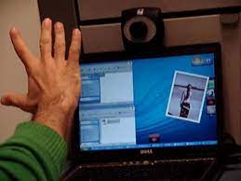
INTRODUCTION
This project proposes an AI virtual mouse system that makes use of the hand gestures and hand tip detection for performing mouse functions in the computer using computer vision.
With the use of the AI virtual mouse system, we can track the fingertip of the hand gesture by using a built-in camera or web camera and perform the mouse cursor operations and scrolling function and also move the cursor with it.
The project covers as a hand recognition tool which could
be used to move the mouse pointer, perform simple
operations like clicking , moving and selecting files.

Slide 5
PROBLEM STATEMENT
The proposed AI virtual mouse system can be used to overcome problems in the real world such as situations where there is no space to use a physical mouse and also for the persons who have problems in their hands and are not able to control a physical mouse. Also, amidst of the COVID-19 situation, it is not safe to use the devices by touching them because it may result in a possible situation of spread of the virus by touching the devices, so the proposed AI virtual mouse can be used to overcome these problems since hand gesture and hand Tip detection is used to control the PC mouse functions by using a webcam or a built-in camera.

Slide 6
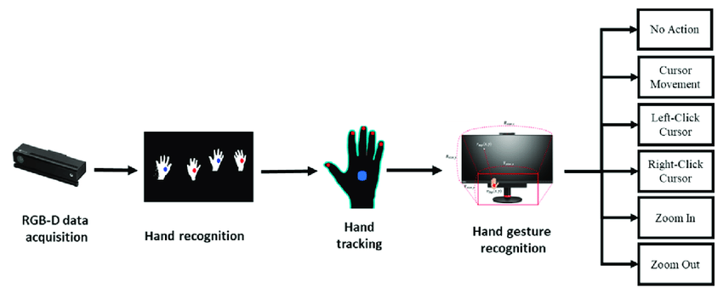
ARCHITECTURE DIAGRAM

Slide 7
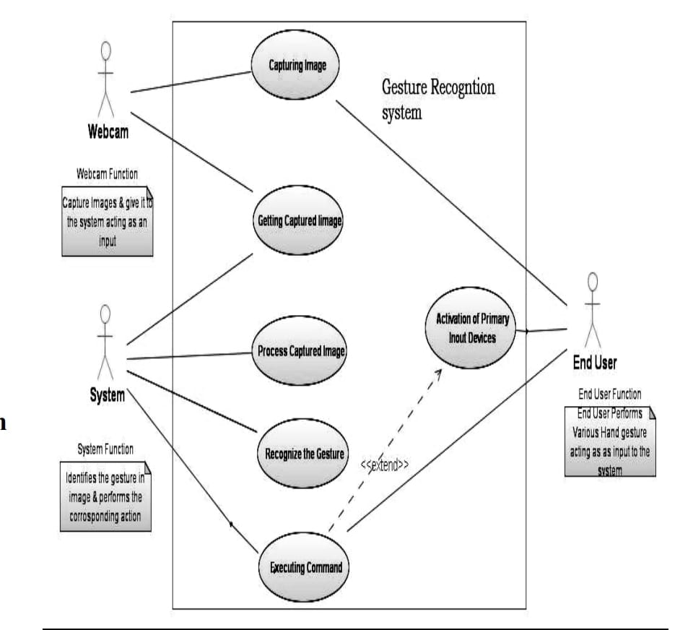
USE CASE DIAGRAM

Slide 8
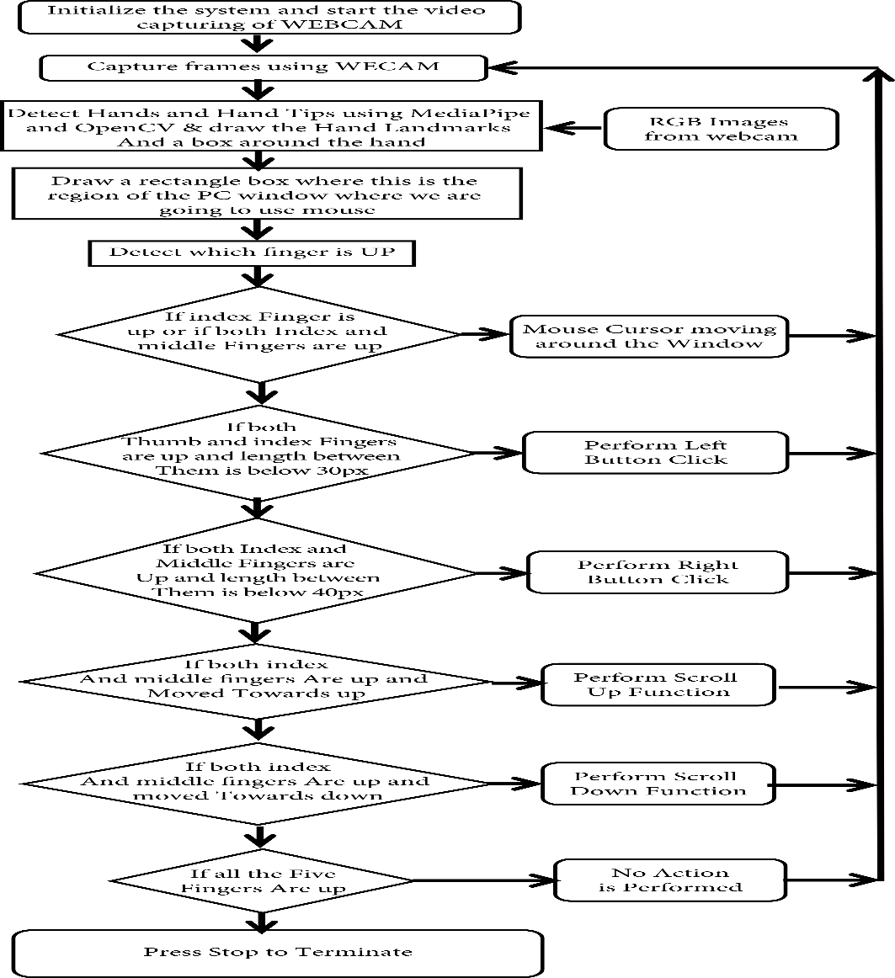
FLOW CHART DIAGRAM

Slide 9
IMPLEMENTATION
Capturing the Video and Processing. The proposed AI virtual mouse system is based on the frames that have been captured by the webcam in a laptop or PC.
Rectangular Region for Moving through the Window.
Detecting Which Finger Is Up and Performing the Particular Mouse Function.
Mouse Functions Depending on the Hand Gestures and Hand Tip Detection Using Computer Vision For the Mouse Cursor Moving around the Computer Window.

Slide 10
For the Mouse Cursor Moving around the Computer Window,
If the index finger is up with tip Id = 1 is up, the mouse cursor is made to move around the window of the computer using the AutoPy package of Python.
If the thumb finger with tip Id = 0 is up, the computer is made to perform the left mouse button click using the Autopy.
If both the index finger with tip Id = 1 and the middle finger with tip Id = 2 are up, the mouse performs right click operation using the pyautogui library.
If both the index finger with tip Id = 1 and the thumb with tip Id = 0are up, the mouse performs upward scrolling operation using the pyautogui library.
If the ring finger with tip Id = 3 is up, the mouse performs downward scrolling operation using the pyautogui library.

Slide 11
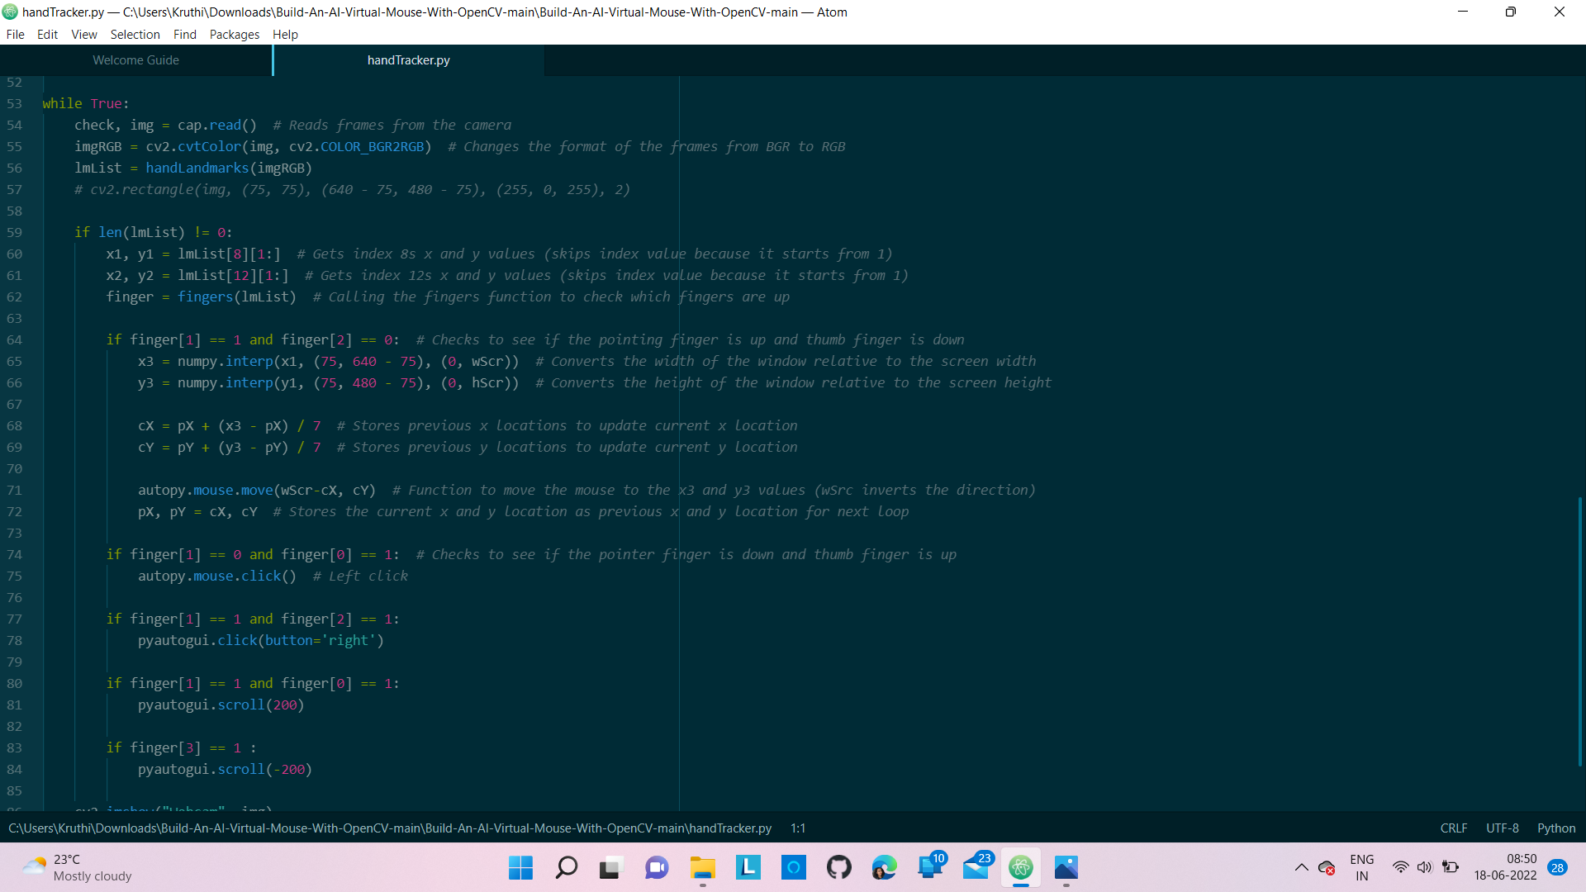

Slide 12
RESULT
The proposed model is so accurate that it can also be used in real-world applications. For example, it can be used to reduce the spread of COVID19 and eliminate the need for wearable devices.
This system is mainly aimed to reduce the use of hardware components attached with the computer.
Recognition and the interpretation of sign language is one of the major issues for the communication with dumb and deaf people. This project is pretty much expressive such that the dumb and deaf people could understand it.
Not only did this project show the different gesture operations that could be done by the users but it also demonstrated the potential in simplifying user interactions with personal computers and hardware systems.

Slide 13
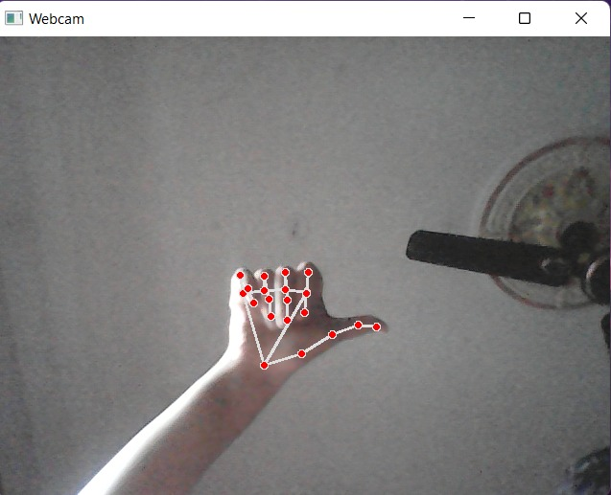
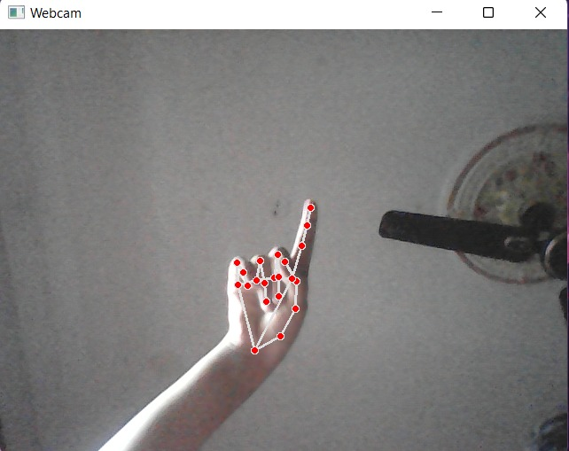
Left-click
Movement of cursor

Slide 14
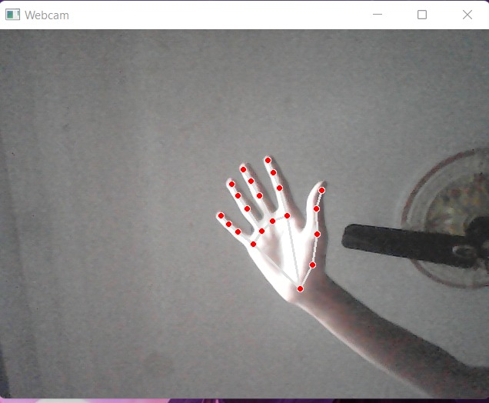
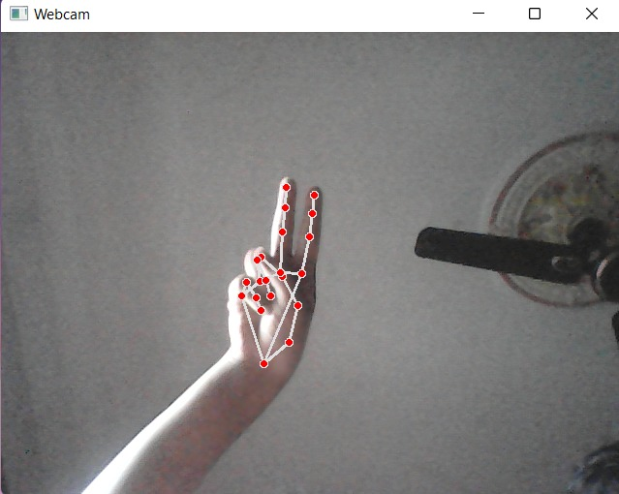
No movement
Right-click

Slide 15
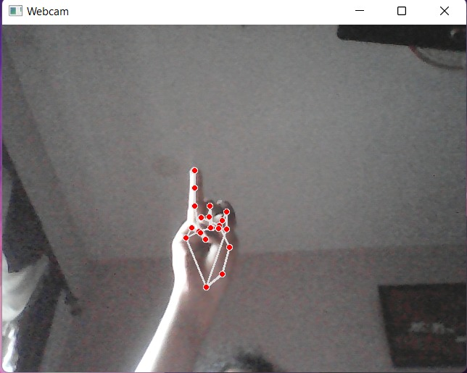
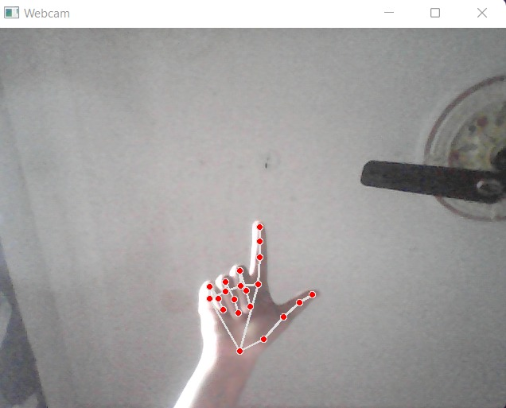
Scroll down
Scroll up

Slide 16
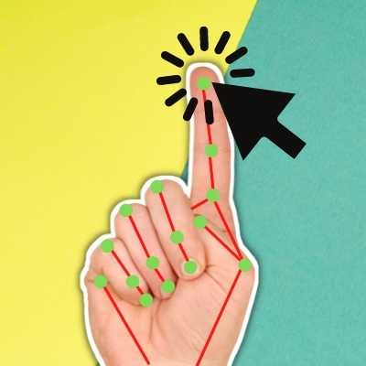
CONCLUSION
The proposed AI virtual mouse system is to develop an alternative to the regular and traditional mouse system to perform and control the mouse functions.
Main objective pre-processing is to represent
the data in such a way that it can be easily
interpreted and processed by the system.
For most laptop touchpad is not the most
comfortable and convenient
It Reduces cost of hardware
It focuses on extracting the features over the
human hands and then matching their features
to recognize the movement of the hand.

Slide 17
REFERENCES
1] Bharath Kumar Reddy Sandra, Katakam Harsha Vardhan, Ch. Uday, V Sai Surya, Bala Raju, Dr. Vipin Kumar “GESTURE-CONTROL-VIRTUAL-MOUSE” .
2] Vijay Kumar Sharma, Vimal Kumar, Md. Iqbal, Sachin Tawara, Vishal Jayaswal. “Virtual Mouse Control Using Hand Class Gesture”. Department of Computer Science and Engineering MIET, Meeru
3] Lira, M., Egito , J.H., Dall’Agnol, P.A., Amodio, D.M., Gonçalves, Ó.F., Boggio , P.S. “ The influence of skin colour on the experience of ownership in the rubber hand illusion” 2017.
4] D. L. Quam, “Gesture recognition with a DataGlove,” IEEE Conference on Aerospace and Electronics, vol. 2, pp. 755–760, 1990. View at: Publisher Site | Google Scholar.
5] Abhilash S , Lisho Thomas, Naveen Wilson, “VIRTUAL MOUSE USING HAND GESTURE” Chaithanya Students Of Dept of computer science and engineering Mar Athanasius College of Engineering

Slide 18
6.Abhik Banerjee, Abhirup Ghosh, Koustuvmoni Bharadwaj,” Mouse Control using a Web Camera based on colour Detection”,IJCTT,vol.9, Mar 2014.
7. Ashwini M. Patil¹, Sneha U. Dudhane¹, Monika B. Gandhi¹, Nilesh J. Uke BE (Information Technology), ] “Cursor Control System Using Hand Gesture Recognition” Sinhgad College of Engineering, Pune, India.

Slide 19

THANK
YOU

